Slide 1

Group 20 CW4 Presentation
Presented By:
Zain Altaf – mza16@student.le.ac.uk
Sonny Powell – sp869@student.le.ac.uk
Dan Dineen– dd264@student.le.ac.uk
Justin Fung – jf376@student.le.ac.uk
Ibrahim Shahid – is220@student.le.ac.uk
Eren Can Arslan – eca22@student.le.ac.uk

Slide 2
Purpose of the Project
Sonny – SP869@student.le.ac.uk

Slide 3
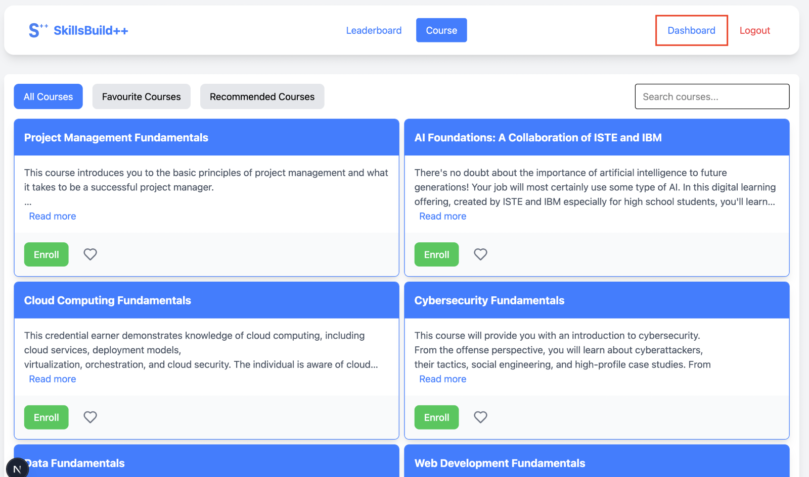
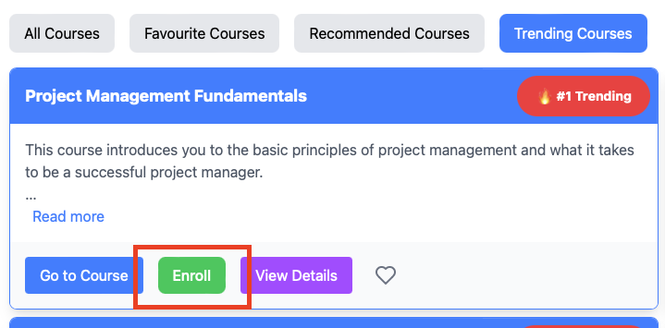
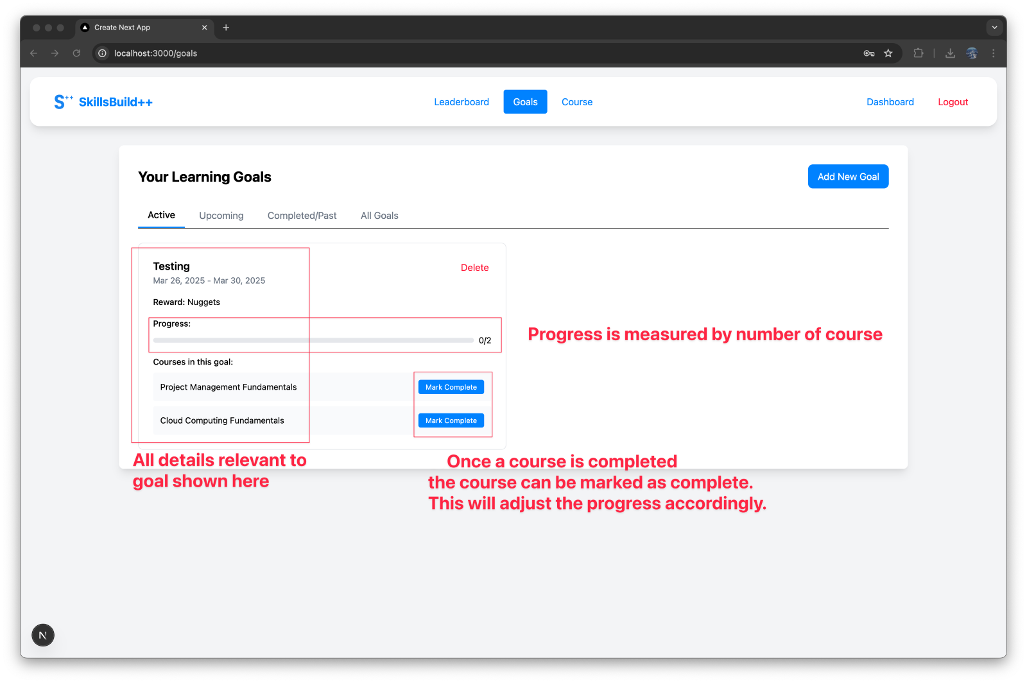
Purpose Overview
Project Goal: A centralised platform for users to discover, enrol and manage their progress for IBM skills build courses
Problem Statement: Difficulty in finding relevant tech skills training in a crowded learning landscape
Target Users: Students, job seekers and professionals.
Key Features: Course Discovery , Enrolment, Progress tracking.

Slide 4
Software Architecture
Dan – dd264@student.le.ac.uk
Notes:
Hi everyone, my name is Dan, and I am going to talk about our Software Architecture.

Slide 5





Tech stack
Notes:
In our solution we’ve adopted a classic three‑tier approach: a Next.js + React frontend, a Spring Boot backend, and a MySQL database. This clear separation keeps our code modular, promotes scalability, and makes it easier to maintain as we grow.

Slide 6
Tech stack overview
Front end
Next.js + React – Modern framework that combines server-side rendering and client-side interactivity
TypeScript, HTML, CSS – Strong typing, structured page markup, and responsive styling
Backend
Java Spring Boot – Robust framework for RESTful APIs, providing security, data access, and scalable architecture
Database
MySQL – Relational database to store structured data with reliable transaction support
Notes:
First, the front end. We’re using Next.js with React because Next.js lets us render pages on the server for fast loading and SEO and React makes the site interactive in the browser. We write everything in TypeScript, so we catch bugs early, and use HTML/CSS (with a simple responsive setup) to make sure it looks good on phones and desktops.
On the back end, we chose Spring Boot in Java. It’s a framework that makes it easy to set up REST APIs. It handles security, lets us inject dependencies so our code is cleaner, and connects to the database with JPA, which saves us a lot of boilerplates.
Finally, our database is MySQL. It’s a solid choice for storing structured data—like user info, courses, and progress. MySQL supports transactions so we don’t lose data, and we add indexes on key fields, so queries stay fast even as we grow.

Slide 7
System architecture
Frontend – Renders the pages and uses React for dynamic components. It sends HTTP requests to the backend for data
Backend – Spring Boot receives requests, applies validation and logic, and queries/updates MySQL as needed
Database - MySQL stores and retrieves application data (e.g. user profiles, courses, progress, etc.)
Notes:
Let me walk you through a typical request:
A user action in the browser triggers an HTTP call from our React components.
Spring Boot receives that call, validates the input, applies any business logic, and interacts with the database through JPA.
MySQL then either retrieves or persists data—everything flows back up through the same layers until the user sees the updated UI.
This end‑to‑end flow keeps each layer focused on its specific responsibility

Slide 8
Key components
Interactive UI
Next.js handles both the server-side rendering and React’s client-side interactions
Responsive & modular design: Easy to maintain and extend
RESTful API
Spring Boot (Java) – Creates endpoints for data operations, secures access, and enforces business rules
Dependency Injection & JPA – Simplifies database interactions and testing
Database Management
MySQL – Reliable relational DB for storing user accounts, course data, progress, etc.
Transactions and Indexing – Ensures data integrity and performance under load
Notes:
Finally, three pillars of our system:
Interactive UI: Next.js handles initial rendering; React takes over for client‑side interactivity. Our components are modular and reusable, so adding new features is straightforward.
RESTful API: Spring Boot exposes secure endpoints for all CRUD operations. With dependency injection and JPA repositories, our code stays clean and testable.
Database Management: MySQL ensures data integrity with transactions and boosts query performance via indexing on key tables.
Together, these elements give us a robust architecture ready to scale and adapt. That wraps up our Software Architecture.

Slide 9
Software design Decisions
Justin – jf376@student.le.ac.uk

Slide 10
Tech stack – cont.

Slide 11
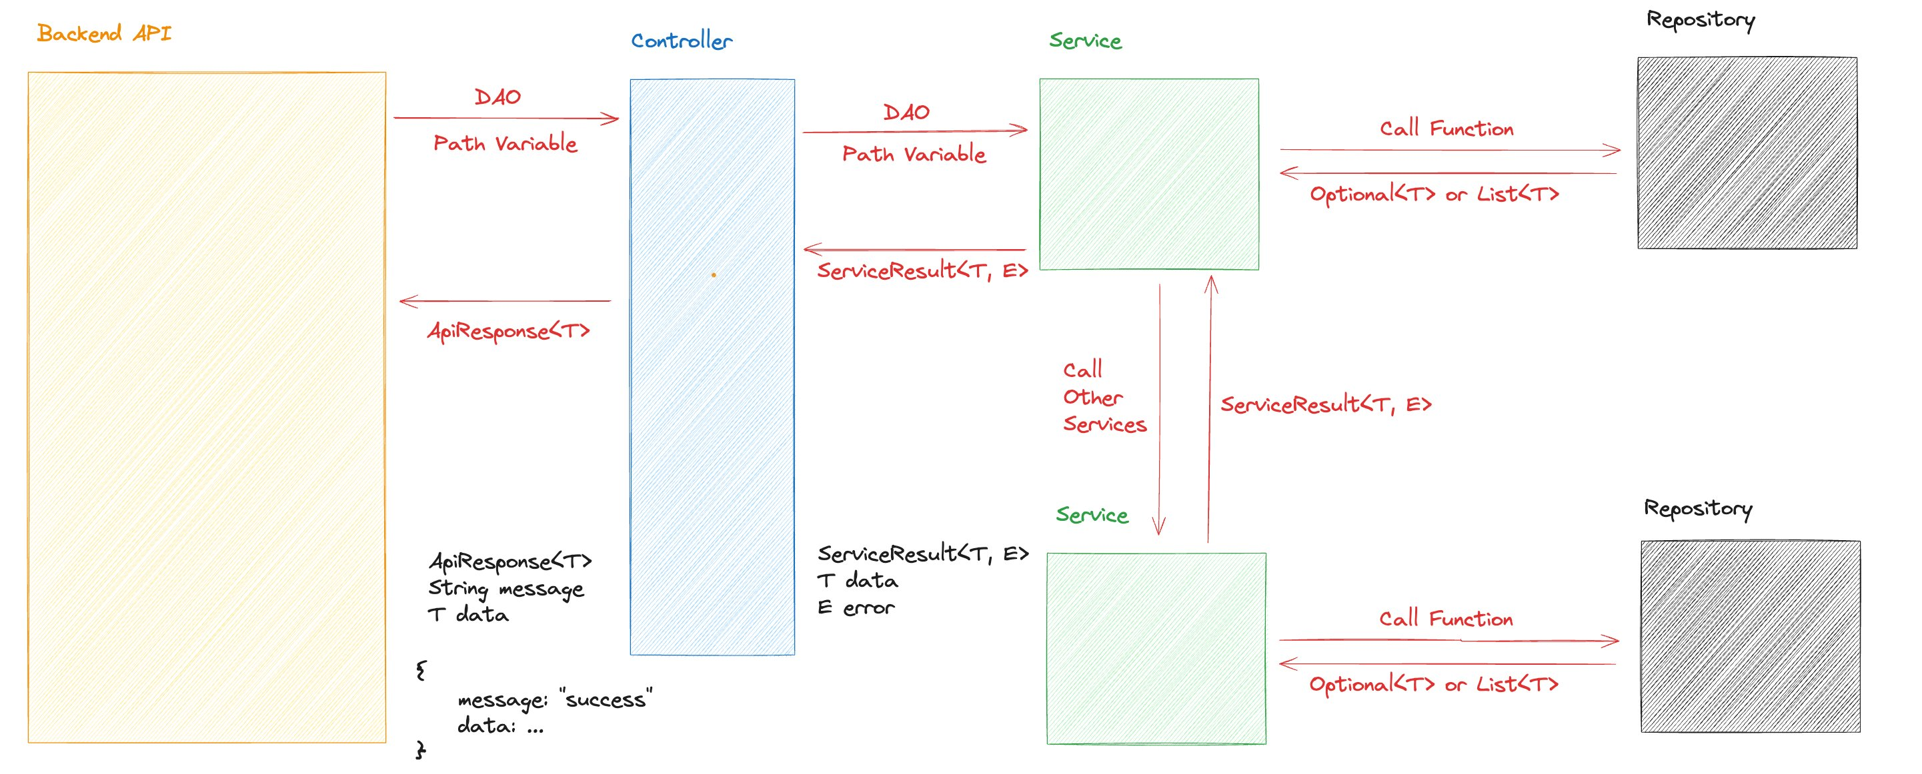
Backend overview

Slide 12
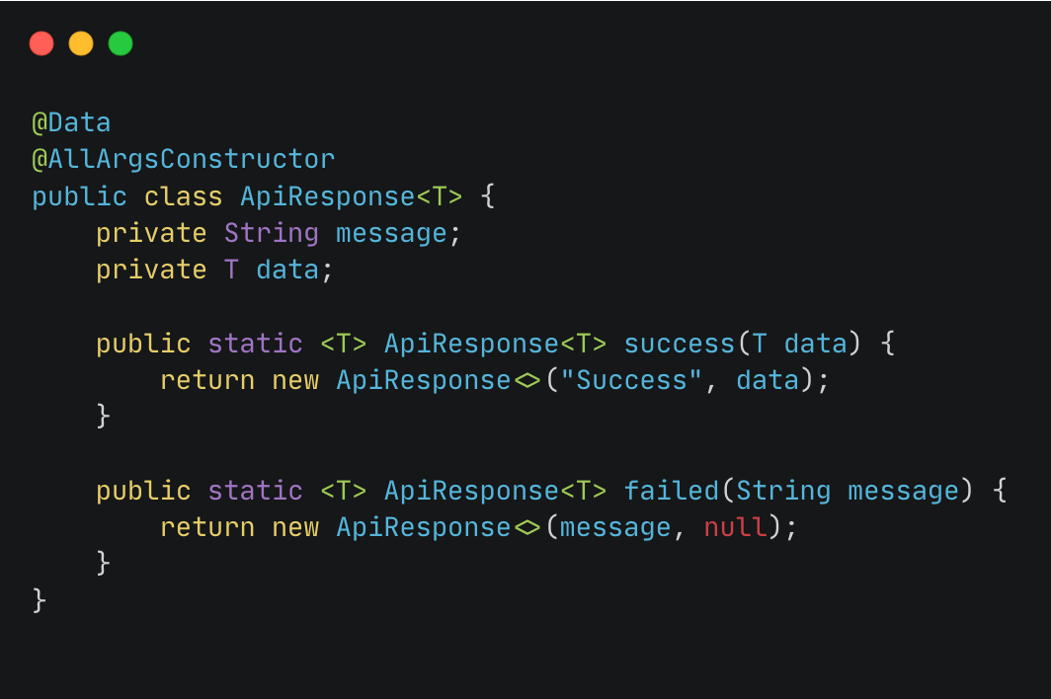
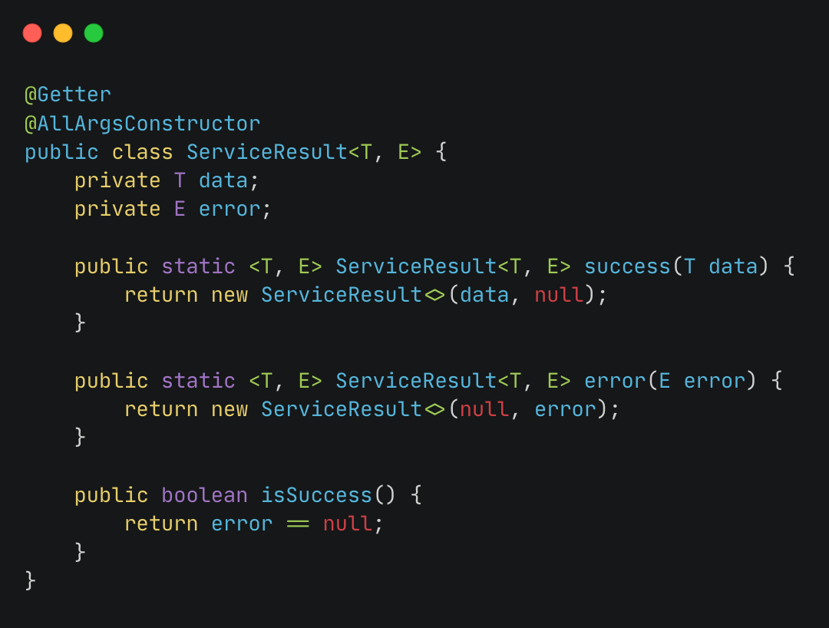
Source code

Slide 13
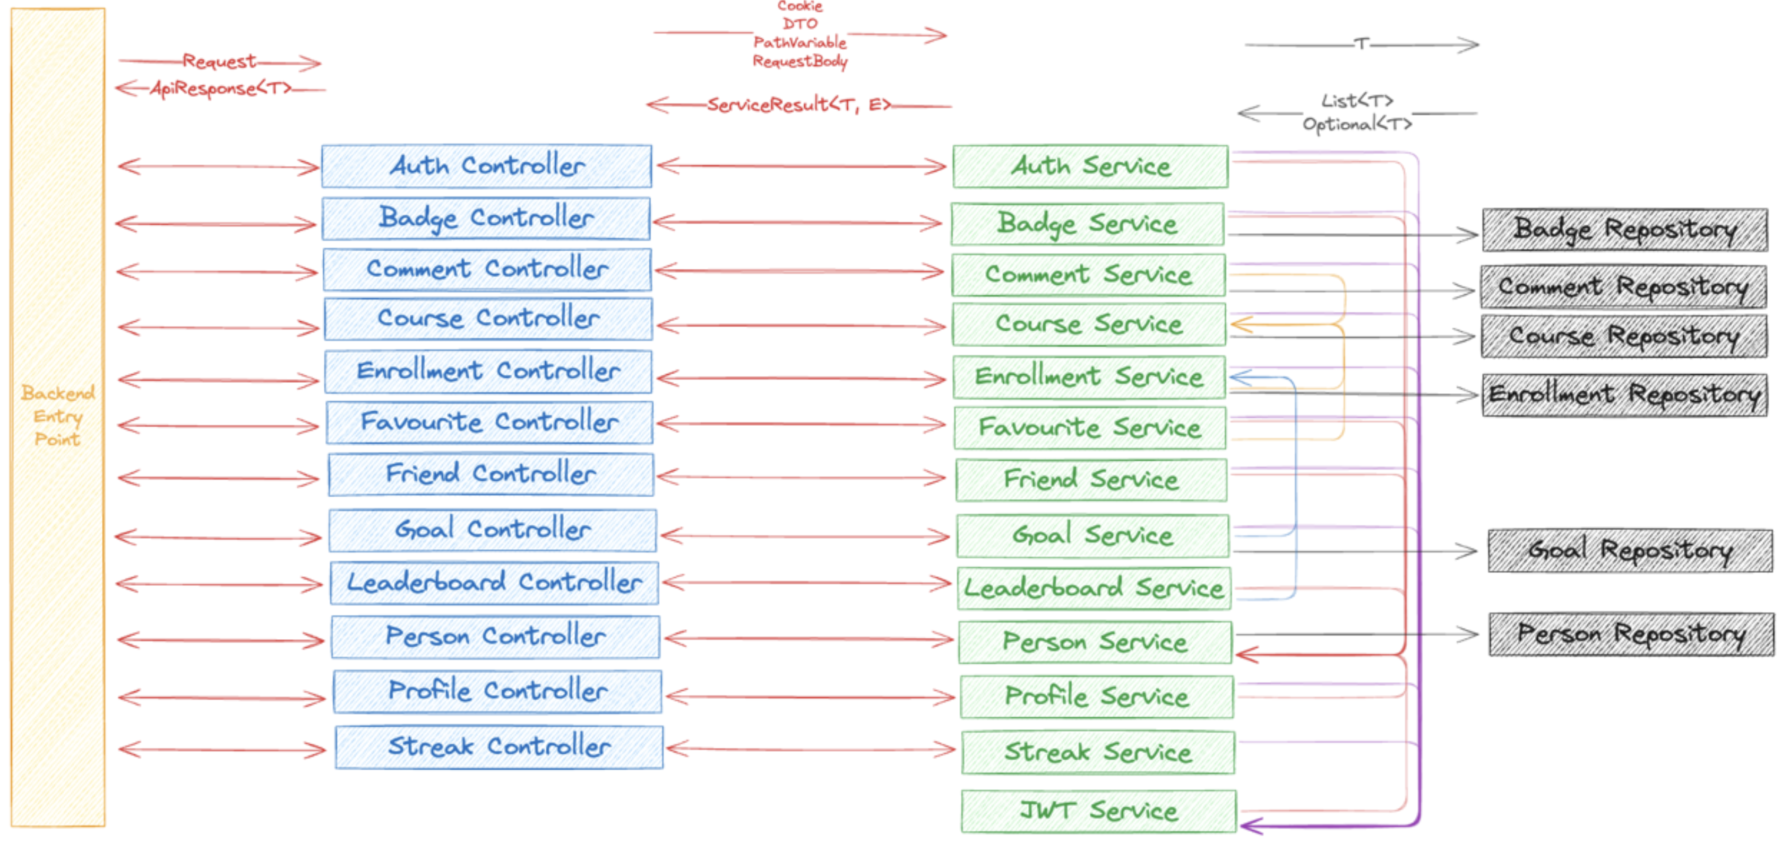

Slide 14
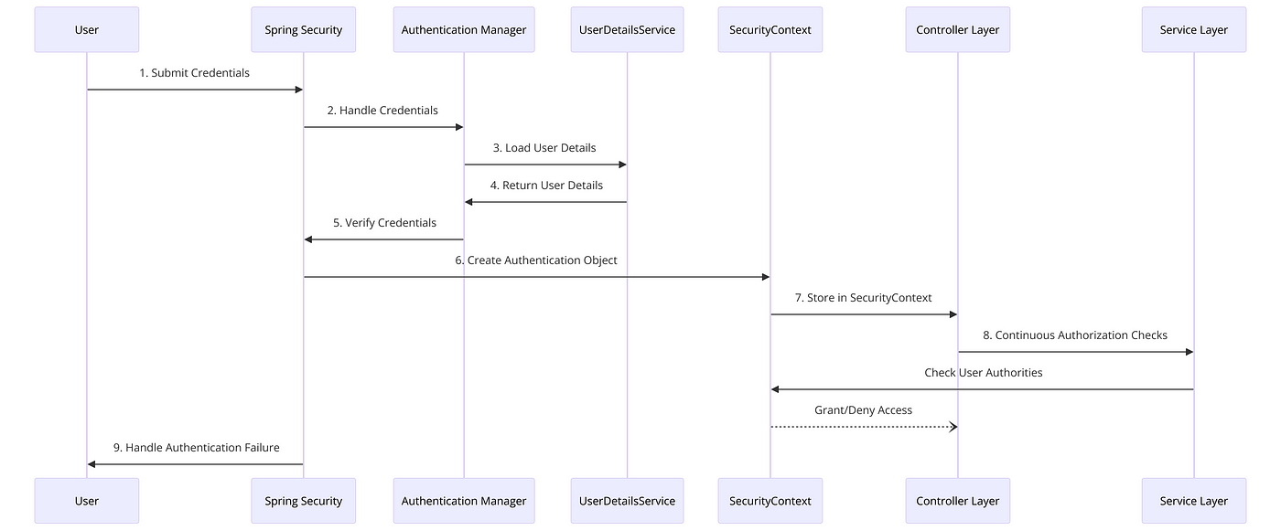
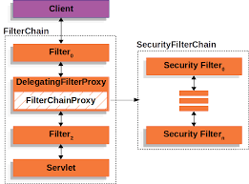
Spring Security
Spring Security documentation, 2024
Wensen Ma, Understanding Spring Security, 2024

Slide 15



Team Communication
Notion
Gitlab
Discord
Zain Altaf – mza16@student.le.ac.uk

Slide 16
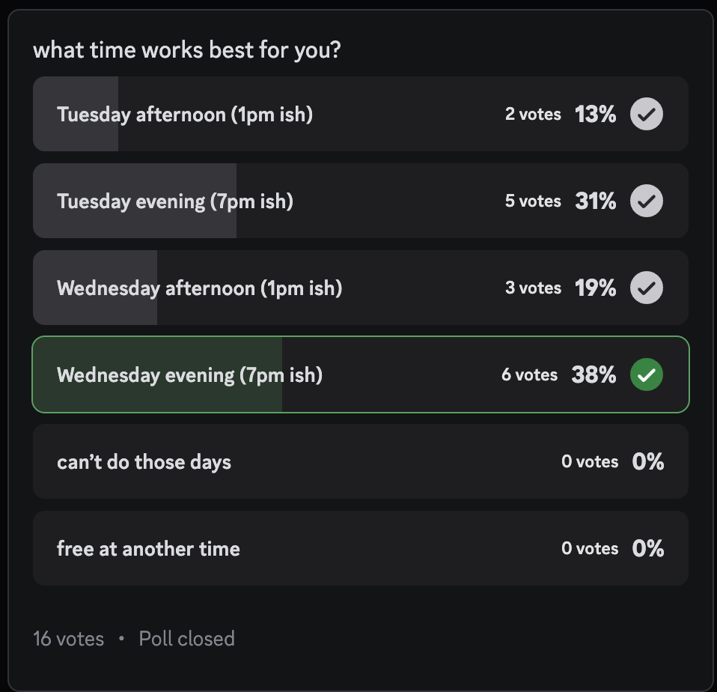
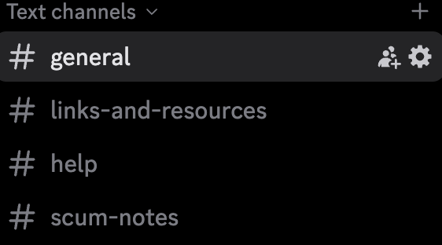
Discord Communication

Slide 17
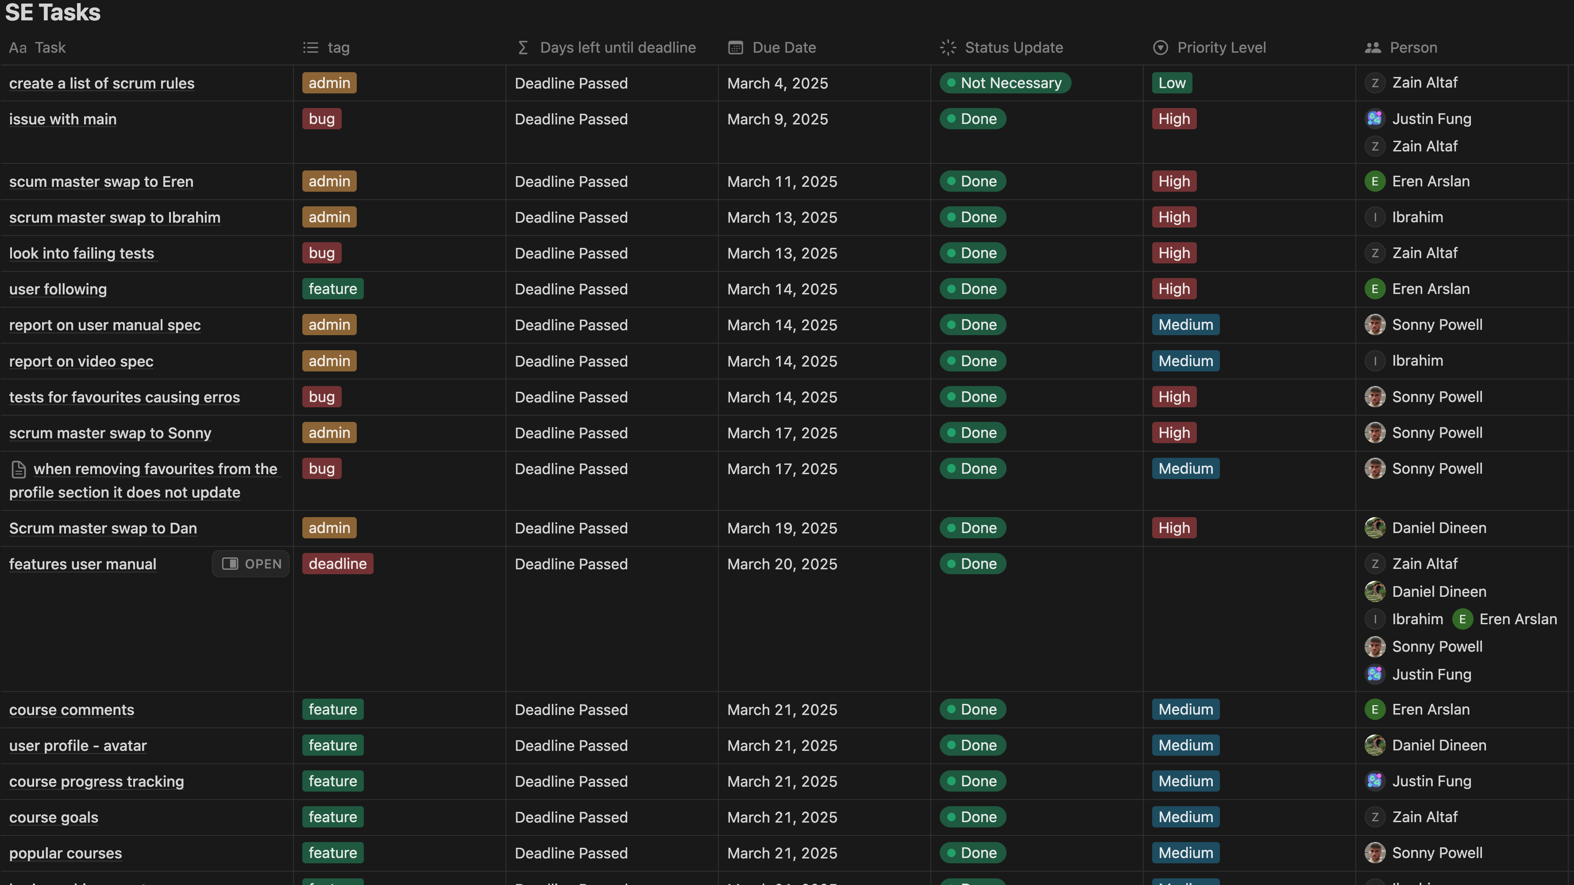
Task Management

Slide 18
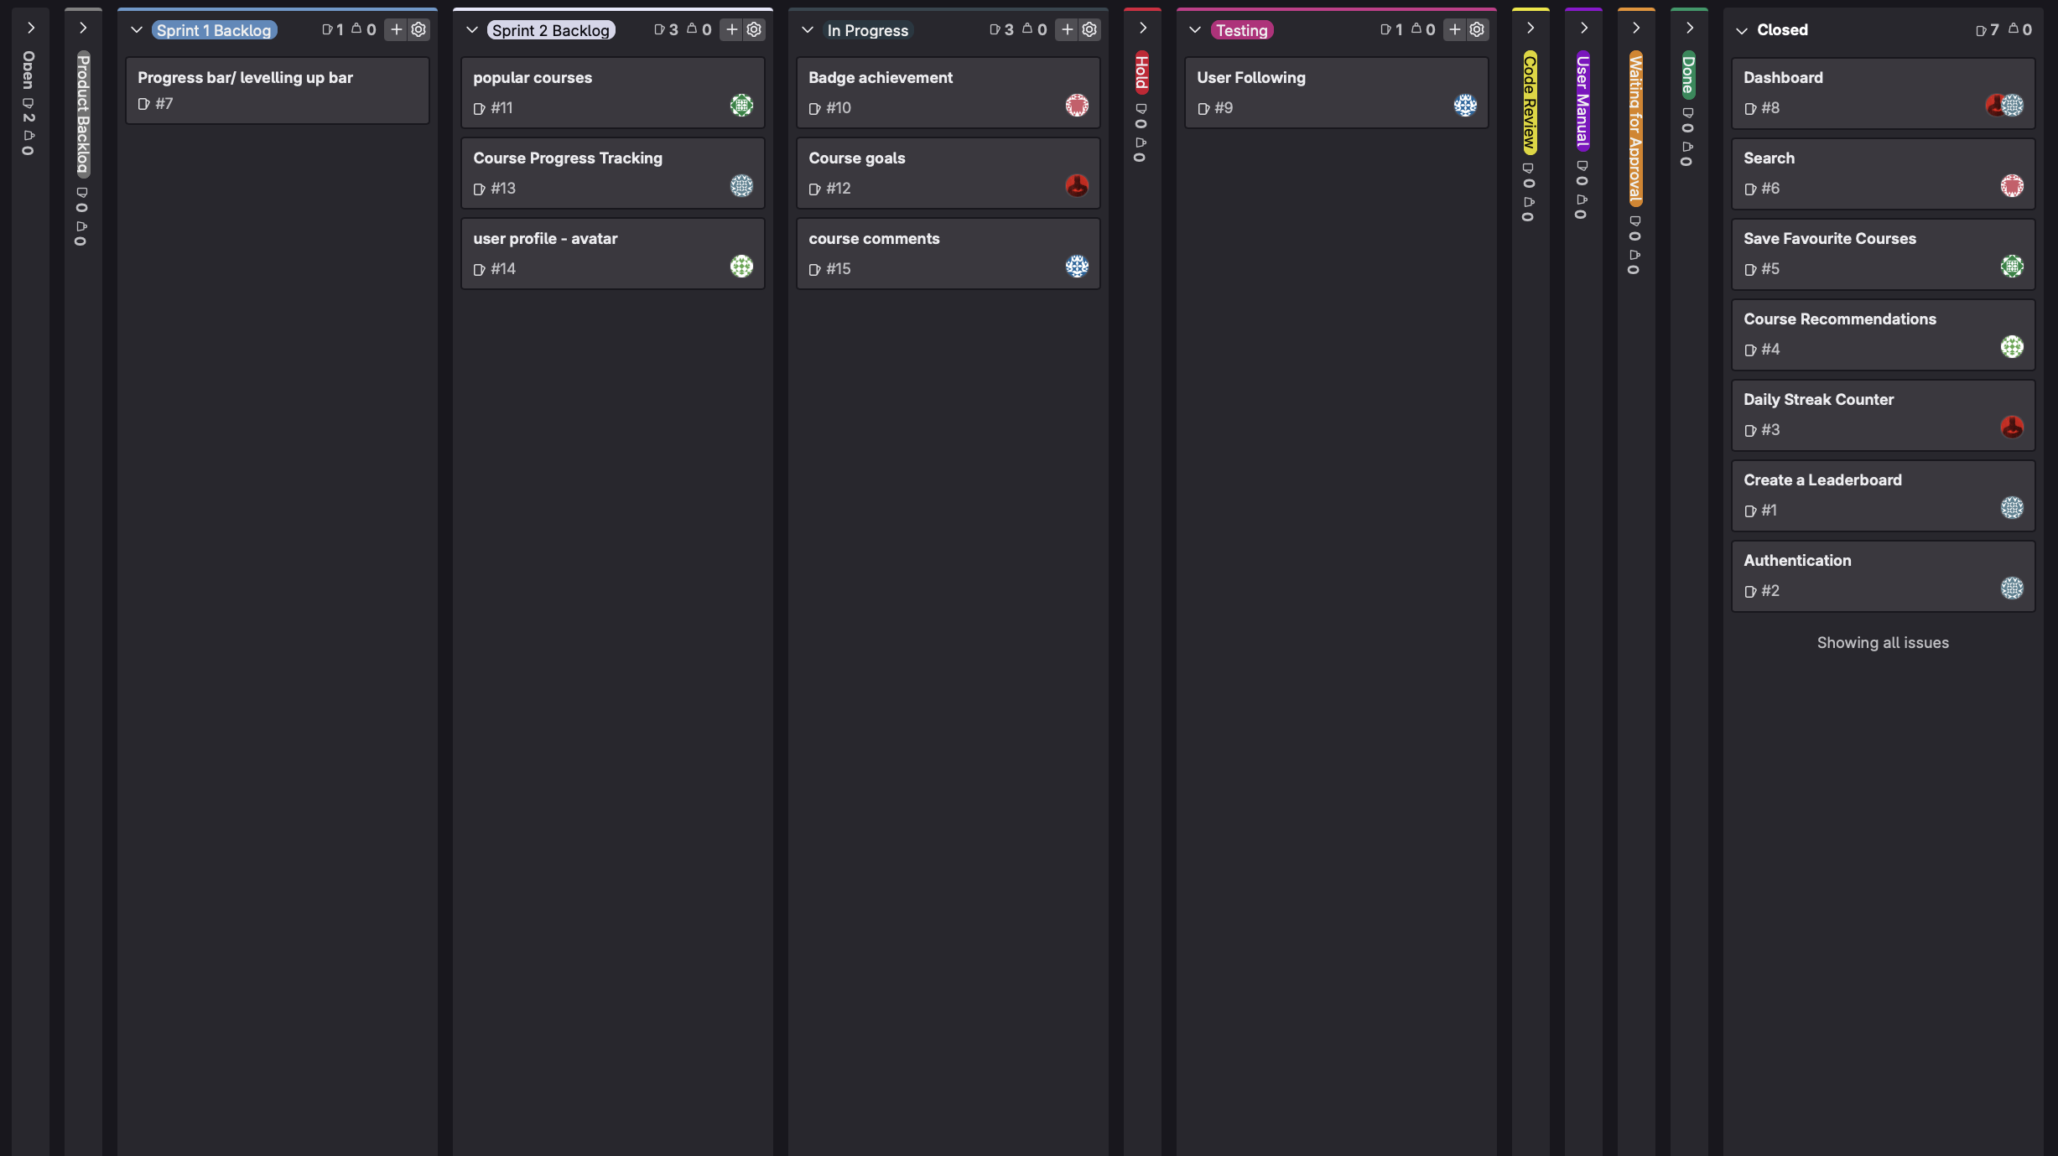
Scrum Board

Slide 19
Communication Learnings

Slide 20
Non-Technical Learnings
Ibrahim – is220@student.le.ac.uk

Slide 21

Unexpected Challenge: Balancing Academics
Multiple academic commitments conflicted
Felt overwhelmed at times
Required quick priority changes
Led to improved time management

Slide 22
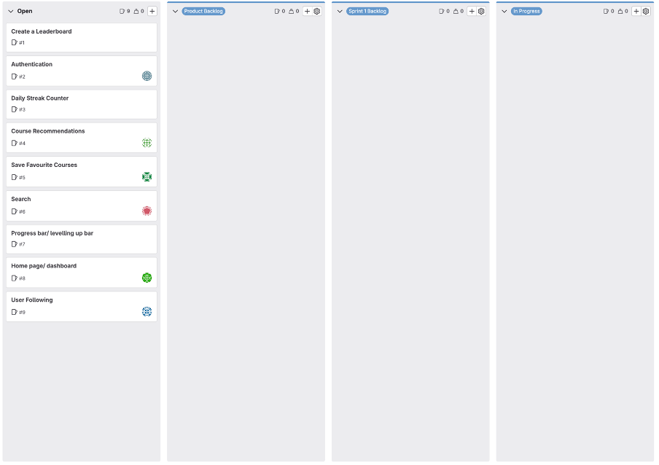
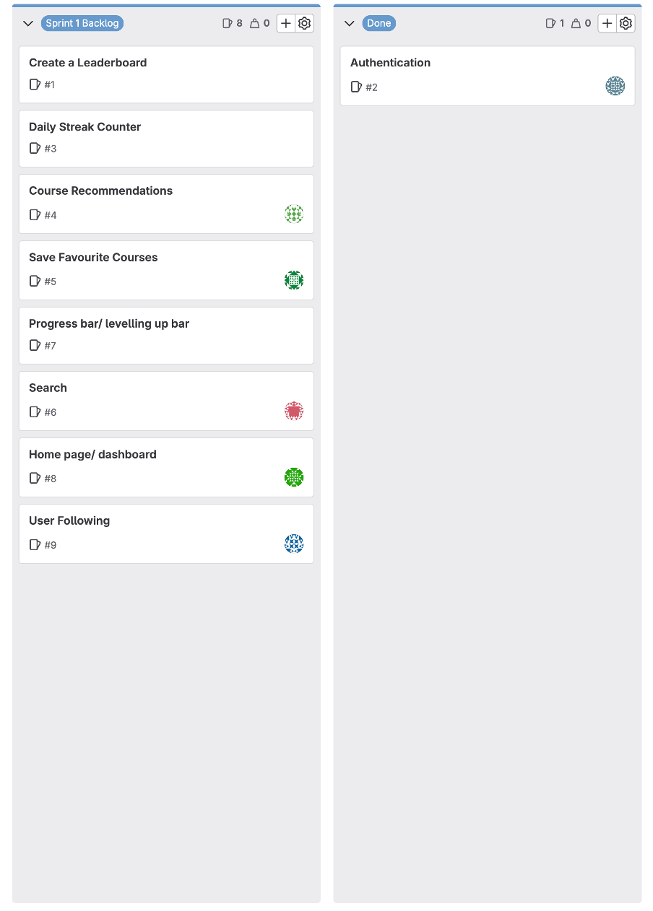
Unexpected Challenge: Team Coordination
Uncertainty in when to begin Sprint 1 work
Led to a delayed and disorganized start
Highlighted the need for early planning and expectations
Reinforced value of shared understanding and communication
Start of Sprint 1
Middle of Sprint 1

Slide 23
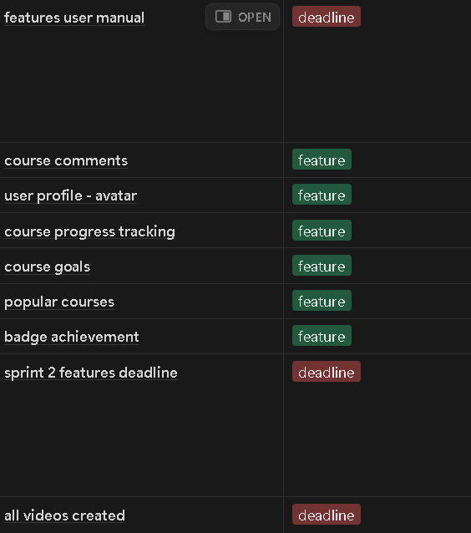
Growth Area: Project Management
Learned to plan proactively under pressure
Developed structured workflows to stay on track
Tools we used to improve planning:
Daily Scrum Meetings for task review
Notion for task tracking and deadlines
Example of some of the tasks we tracked on Notion

Slide 24

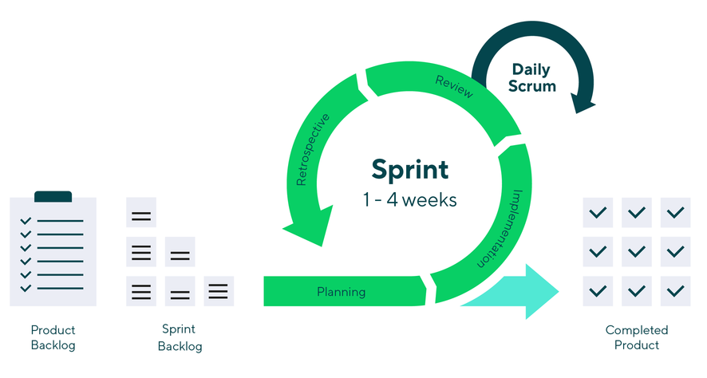
Growth Area: Team Collaboration
Role Rotation:
Broadened my leadership perspective
Encouraged open discussions and ensured every team member's input was heard
Comfort in Agile:
Embraced sprints & iterative updates
Adapted quickly to shifting priorities
Role Rotation
Agile methodology loop diagram

Slide 25

KEY INSIGHT
Strong teamwork requires early structure and shared responsibility
Daily scrums and clear routines improved coordination
Communication and planning turned early struggles into progress

Slide 26
Future Plans
Eren – eca22@student.le.ac.uk

Slide 27
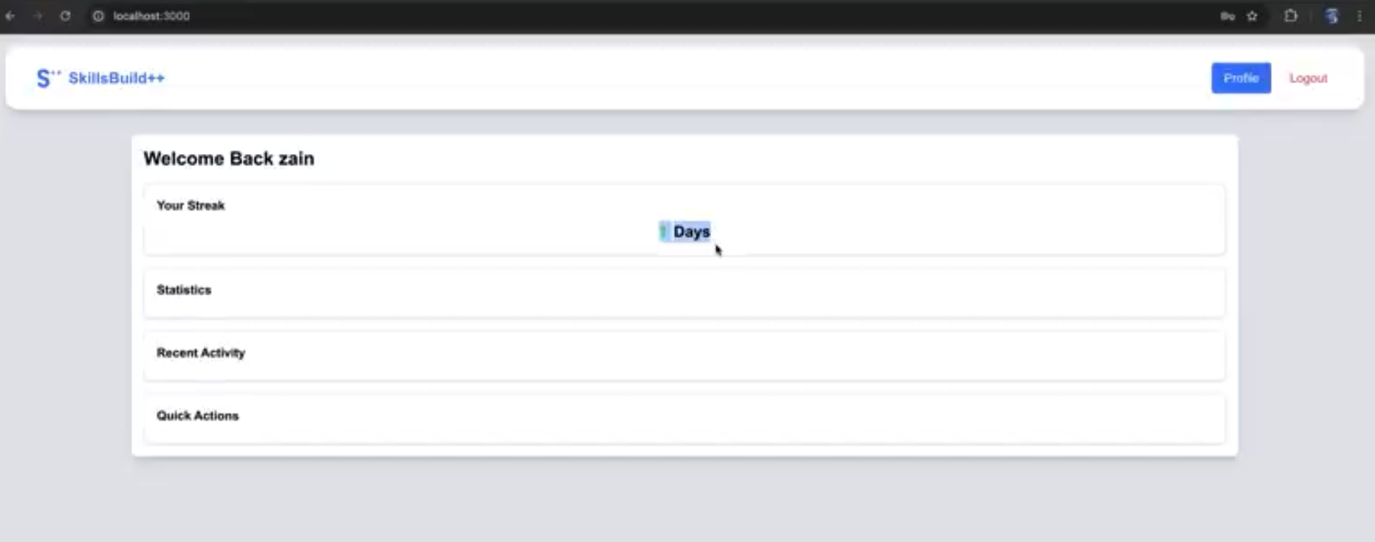
Feedback from users and developers
Different sizes, weightings, and no animation
Design a medium fidelity feature implementation so the devs know what to do.

Slide 28
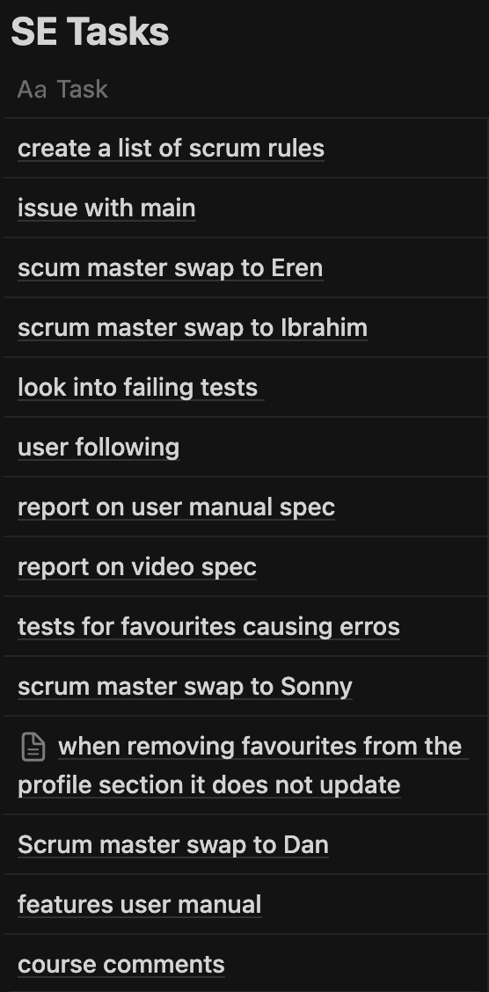
Feedback from users and developers
Developer:
By having subtasks for tasks, we can create a schedule so we do not run into waiting for our team to complete a feature so someone could work on theirs.

Slide 29
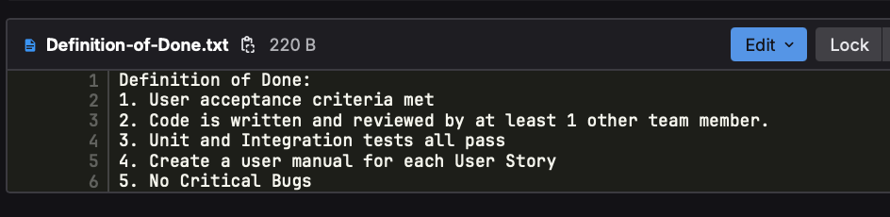
Feedback from users and developers
If we had a specific merge request specification, it would have lead to less merge conflicts and saved time.

Slide 30
Thank you for Listening

